Slide 1

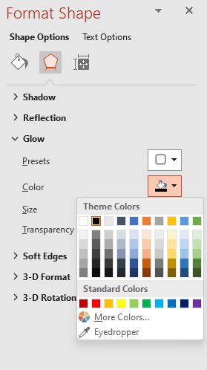

Light/Dark cursors
Could use without permission*
Colour cursors
To make a custom cursor…
Select the cursor, not the background.
In the Format Shape, select Gradient Fill or Soild Fill to make your cursor amazing.
BONUS: Click the to change the glow effect, look at picture 1 to know where to change glow colour.
4. Now you want to SAVE this image, right-click the cursor’s group and Save as Picture.
Now you need a converter to convert it to .cur
Try it yourself:
(1)
use what you seen in a special colour in images or SVGs
*Because sample colours in Cur are free, but sample images were with permission of hard work. Cur may vary in some countries.

